Slide 1



CIVICS CHAPTER-2
CLASS-7
ROLE OF THE GOVERNMENT IN HEALTH

Slide 2
INTRODUCTION
In a democracy people expect the government to work for
their welfare.
This could be through the provision of
education, health, employment, housing or the development
of roads, electricity etc.
In this chapter we shall examine the meanings and problems
related to health.

Slide 3
What is health?
Health means our ability to remain free of illness and
injuries. But health isn’t only about disease.
Apart from disease, we need to think of other factors that
affect our health. For example, if people get clean drinking
water or a pollution free environment they are likely to be
healthy.
 On the other hand, if people do not get adequate food to
eat or have to live in cramped conditions, they will be
prone to illness.
It isn’t healthy to be dull, inactive, anxious or scared for long
stretches of time.
We all need to be without mental strain.

Slide 4
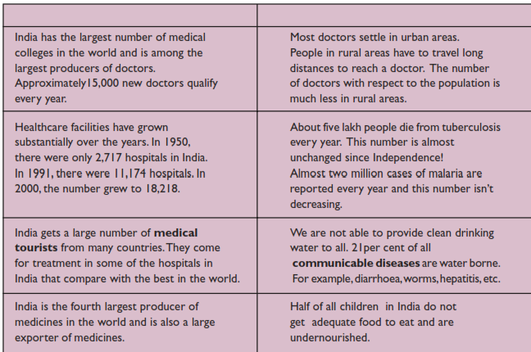
Healthcare in India
•There has been a
phenomenal
advancement in medical
sciences.
•However, the second column
points out how poor
the health situation in our
country is. With all the
above positive developments
we are not able to
provide proper healthcare
facilities to people.
• This is the paradox –
something that is contrary to
what we would expect.

Slide 5
Healthcare in India
In order to prevent and treat illnesses we need
appropriate healthcare facilities such as health
centres, hospitals, laboratories for testing,
ambulance services, blood banks, etc., that can
provide the required care and services that patients
need.
Our country has the money, knowledgeand people with
experience but cannot make the necessary healthcare
available to all

Slide 6
Healthcare Services in India
Public Healthcare
Private Healthcare

Slide 7
Public health services
The public health service is a chain of health centres and
hospitals run by the government.
They are linked together so that they cover both rural and
urban areas and can also provide treatment to all kinds of
problems – from common illnesses to special services.
At the village level there are health centres where there is
usually a nurse and a village health worker.
They are trained in dealing with common illnesses and work
under the supervision of doctors at the Primary Health
Centre (PHC).

Slide 8
Public health services
The health service is called ‘public’ for many reasons. In
order to fulfil its commitment of providing healthcare to all
citizens, the government has established these hospitals and
health centres.
The resources needed to run these services are obtained
from the money that we, the public, pay to the government
as taxes. Hence, such facilities are meant for everyone.
 One of the most important aspects of the public health
system is that it is meant to provide quality healthcare
services either free or at a low cost, so that even the poor can
seek treatment.

Slide 9
Private health facilities
There is a wide range of private health facilities that exist in
our country. A large number of doctors run their own private
clinics.
In the rural areas, one finds Registered Medical Practitioners
(RMPs). Urban areas have large number of doctors, many of
them providing specialised services.

There are hospitals and nursing homes that are privately
owned.
Thereare many laboratories that do tests and offer special
facilities such as X-ray, ultrasound, etc. There are
also shops from where we buy medicine.

Slide 10
Private health facilities
Today the presence of private facilities can be seen
all around.
In fact now there are large companies that run hospitals and
some are engaged in manufacturing and selling medicines.
As the name suggests, private health facilities are not owned
or controlled by the government. Unlike the public health
services, in private facilities,patients have to pay a lot of
money for every service that they use.

Slide 11
Healthcare and equality:
Is adequate healthcare available to
all?
In India, we face a situation where private services are
increasing but public services are not. What is then available
to people are mainly private services.
These are concentrated in urban areas. As theseservices are
run for profit, the cost of these services is rather high.
Medicines are expensive. Many peoplecannot afford them or
have to borrow money when there is an illness in the family.
 For those who are poor, every illness in the family is a cause
of great anxiety and distress.

Slide 12
Healthcare and equality:
Is adequate healthcare available to
all?
Those who are poor are in the first place
undernourished. These families are not eating as
much as they should. They are not provided basic
necessities like drinking water, adequate housing,clean
surroundings, etc.
Sometimes it is not only the lack of money that prevents
people from getting proper medical treatment. Women, for
example, are not taken to a doctor in a prompt manner.
Many tribal areas have few health centres and they do not run
properly.Even private health services are not available.

Slide 13
What can be done?
There is little doubt that the health situation of most
people in our country is not good.
 It is the responsibility of the government to provide quality
healthcare services to all its citizens, especially the
poor and the disadvantaged.
However, health is as much dependent on basic amenities and
socialconditions of the people, as it is on healthcare services.
 Hence, it is important to work on both inorder to improve
the health situation of our people.And this can be done.

Slide 14
The Kerala experience
In 1996, the Kerala government made some majorchanges in
the state. Forty per cent of the entire statebudget was given
to panchayats.
They could plan and provide for their requirements.
This
made it possible for a village to make sure that proper
planning was done for water, food, women’s development
and education.
This meant that watersupply schemes were checked, the
working of schools and anganwadis was ensured and specific
problems of the village were taken up.

Slide 15
The Costa Rican approach
Costa Rica is considered to be one of the healthiest countries
in South America.
The main reason forthis can be found in the Costa Rican
Constitution.Several years ago, Costa Rica took a very
importantdecision and decided not to have an army.
This helped the Costa Rican government to spend the
money that the army would have used, on health,education and
other basic needs of the people.
TheCosta Rican government believes that a country has to be
healthy for its development and pays a lot of attention to the
health of its people.

Slide 16
Thank you

